Slide 1


DAMG 6210 Data Management and Database Design
GYM MANAGEMENT SYSTEM
TEAM 09
Kushal Upadhyay
Vrushali Phaltankar
Pratik Prakash Sannakki
Amit Yadav
Hemanth Ramesh

Slide 2
OBJECTIVE
A Gym Database Management System is a software solution designed to efficiently manage and store data related to a gym center's operations, including membership information, attendance records, fee payments, and equipment inventory maintenance reports. Such a system helps streamline billing processes, automate billing cycles, and track revenue in real-time.
Implementing a Gym Database Management System can enhance a gym center's operations by providing easy access to essential data and generating accurate reports for decision-making purposes.
1
2
Avoiding redundant customer records, guarding against data loss, and maintaining records efficiently.
To keep track of the members and their plans, and to communicate with them efficiently.
3
4
To create reports on various operations within the gym, including membership fee payment, which can be analyzed to get clear information about the members.
To provide a variety of alternatives, in terms of equipment, different fitness coaches based on availability and fee payment updates as well.

Slide 3
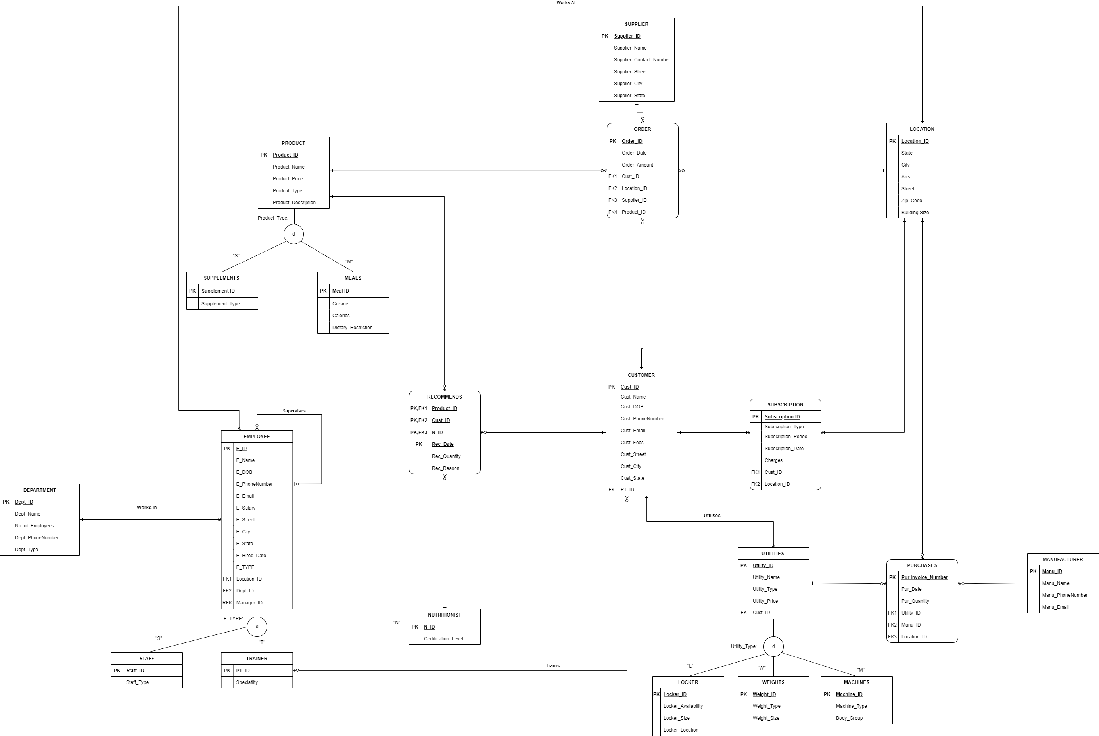
ERD DIAGRAM

Slide 4
HIGH LEVEL DESIGN
Scope and requirements
Create Table Structure
Defining the scope of the project
and functional parameters for
identifying necessary entities and
relationships
In this phase, we are creating
table structures for all major
entities of a Gym
Data Insertion
Stored Procedure, Functions and Triggers
In this phase, we are inserting
data into all tables with respect
to their primary and foreign key
relations
Stored procedures for assigning
trainers and list of customer, triggers
for maintaining subscription audit and
for calculating percentage of total purchase

Slide 5
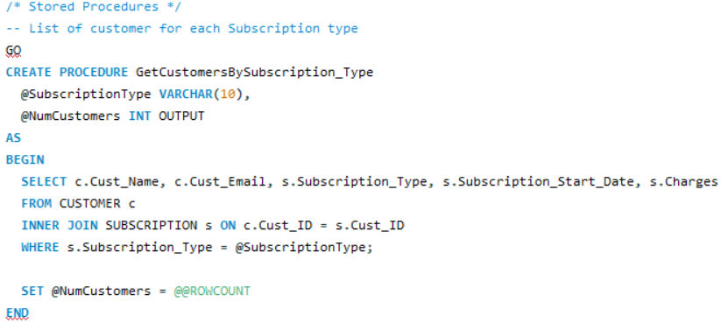
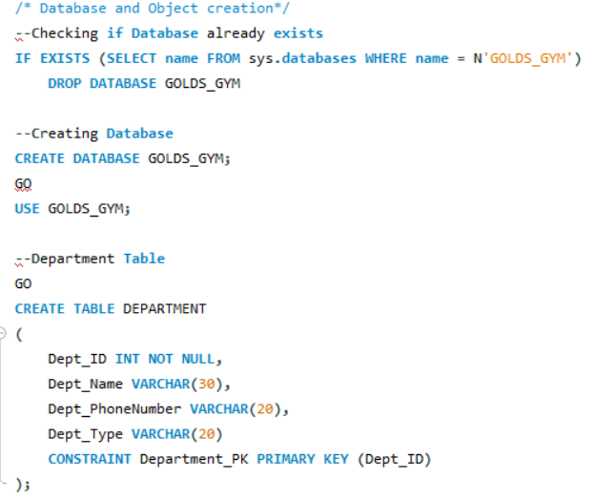
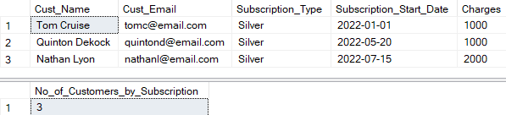
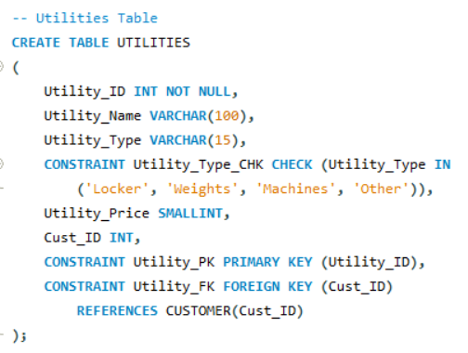
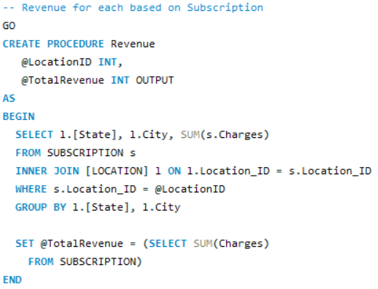
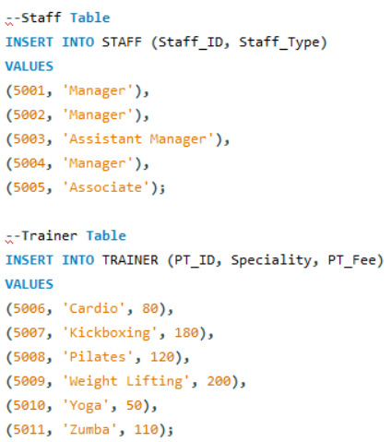
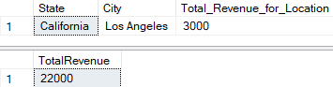
DDL STATEMENTS AND STORED PROCEDURES
ENTITIES
Customer
Utilities
Supplier
Order
Product
Employee
Department
Subscription
Manufacturer
Location

Slide 6
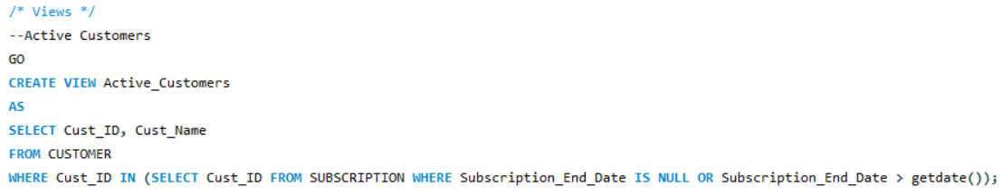
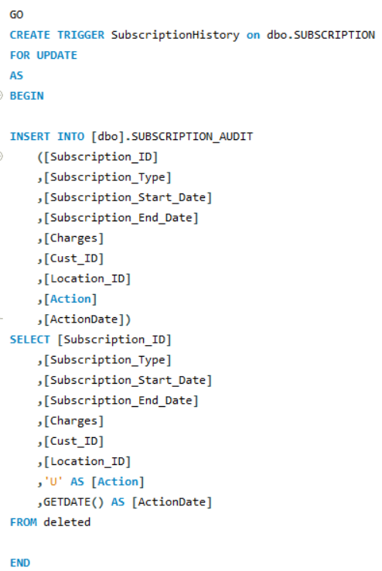
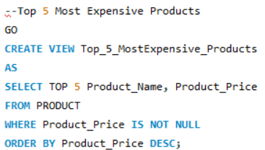
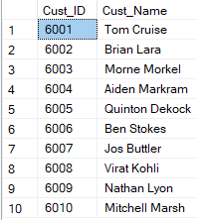
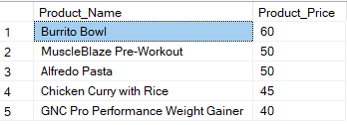
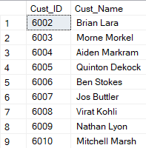
VIEWS AND TRIGGERS
Views of Active Customers
Trigger of Subscription History
View of Top 5 Most Expensive Products

Slide 7
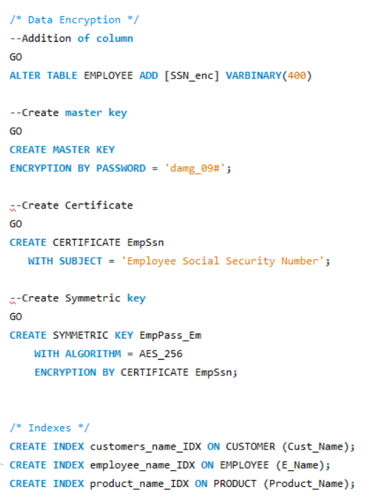
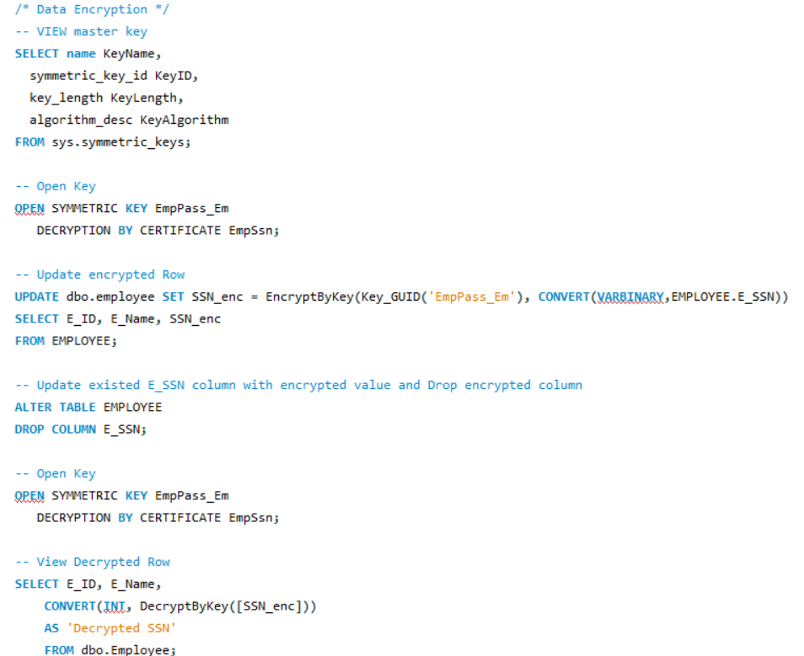
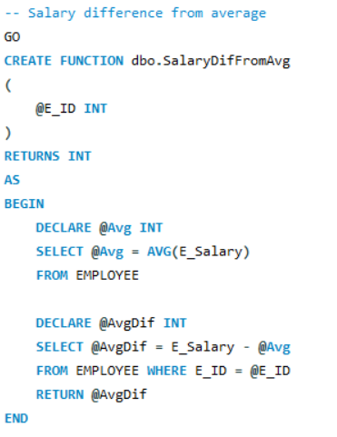
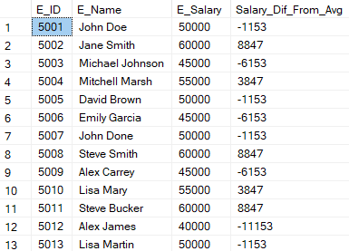
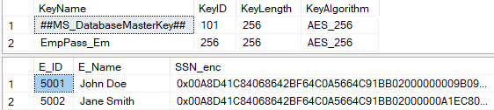
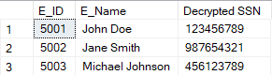
DATA ENCRYPTION AND FUNCTIONS

Slide 8
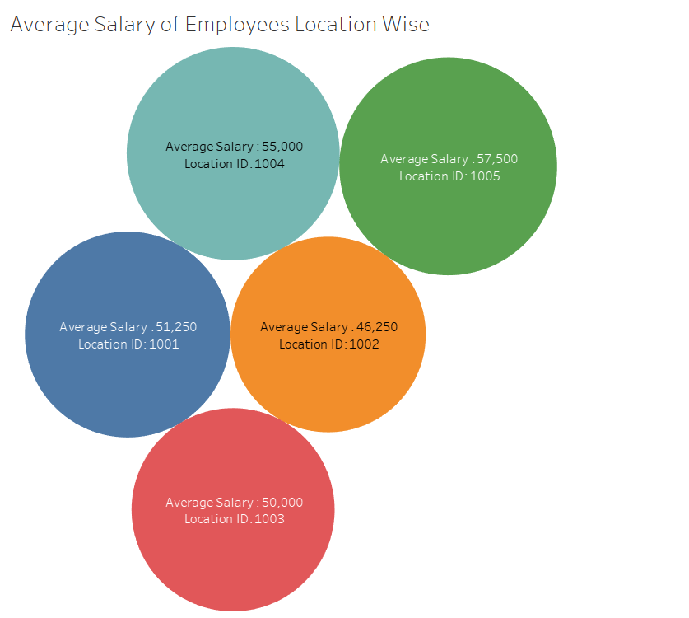
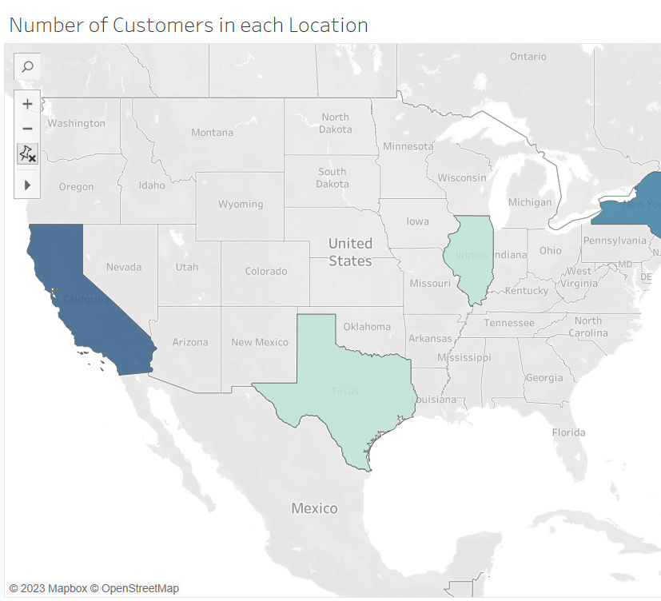
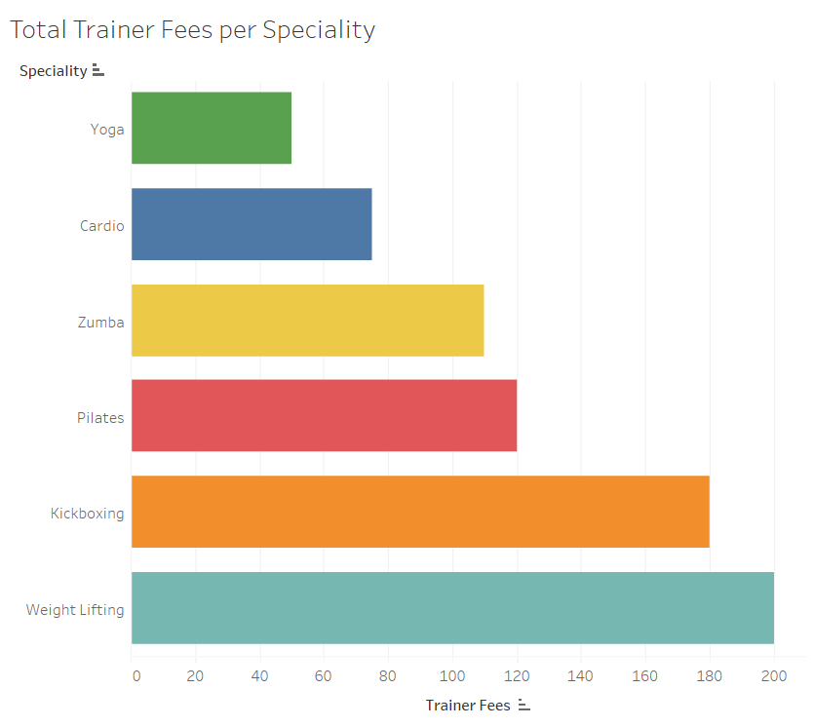
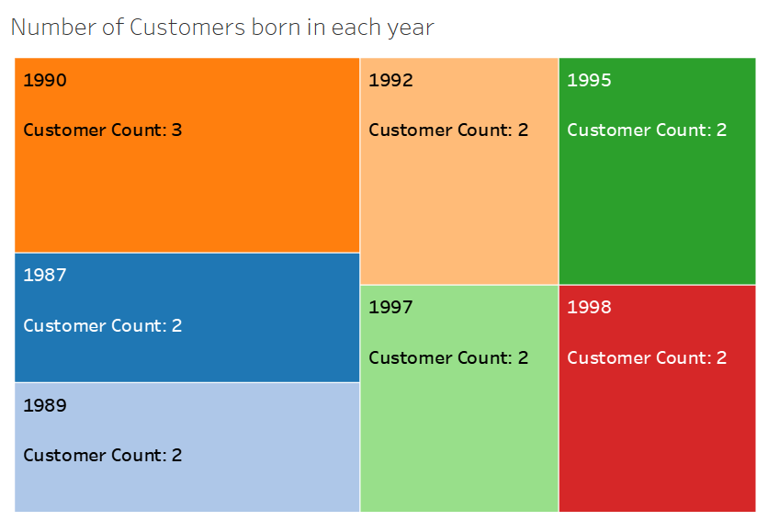
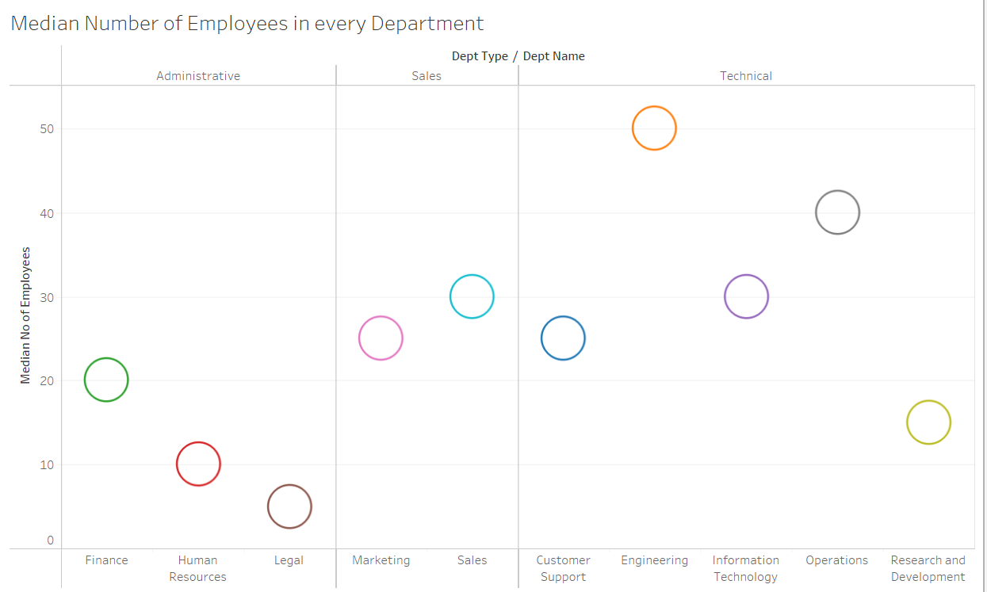
VISUALIZATION

Slide 9
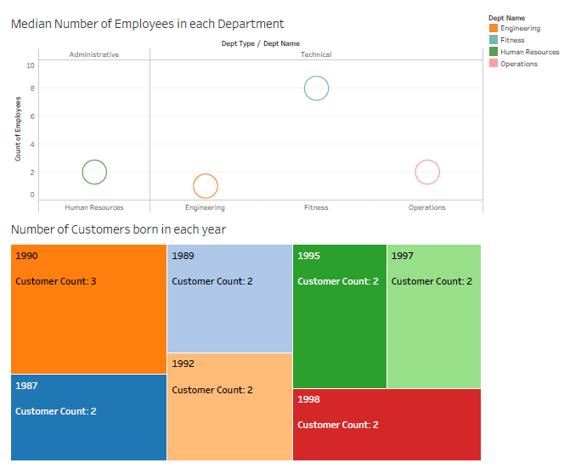
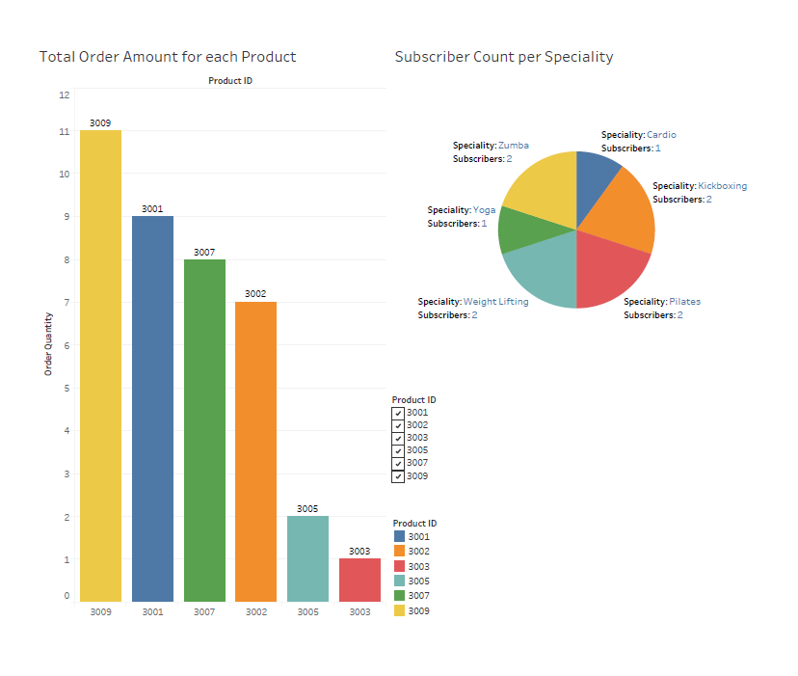
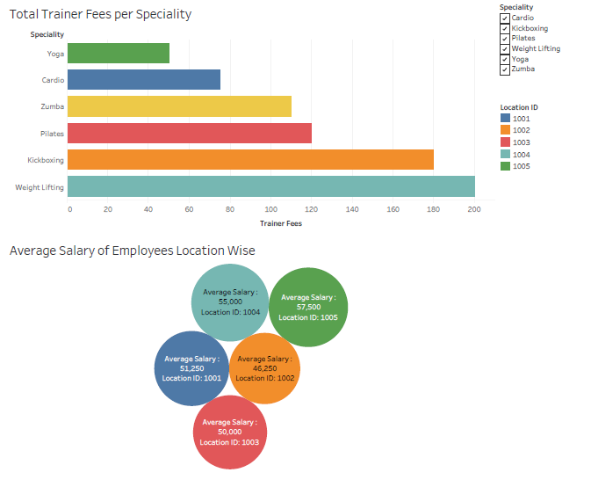
VISUALIZATION

Slide 10
OUTCOMES
Based on the requirements analysis phase, the "Gold's Gym Management System" has been created to fulfill the necessary requirements. This system is designed to be user-friendly, with efficient form and field level validations. The previous manual system had various drawbacks, so this project was developed to address these issues and meet the expectations of modern times.
Future Scope:
There are also few features which can be integrated with this system to make it more flexible. Below list
shows the future points to be consider:
Real-time Chat BOT option for members and trainer, so that members can directly enquiry their trainer on any time through the Chat BOT.
Automated Fitness suggestion by enquiring the condition of the health.
Real time Claim Processing Bot.
Video conversation option for trainers and members.
Online payment through face recognition.
Barcode generation for membership card and using this, members can take entry to Gym.
Fingerprint matching for taking entry to gym.
THANK YOU

